Slide 1
Analysis and identification of malicious mobile applications
CSE7101- Capstone Project
Review-1
Batch Number: COM_14
Under the Supervision of,
Dr./Mr./Ms./Prof. Mr.Asif Ahmad Najar
Professor / Associate Professor / Assistant Professor
School of Computer Science and Engineering
Presidency University
Student Name | Roll Number
AMISHA | 20221COM0170
PRIYANKA | 20221COM0219
SHREYAS B R | 20221COM0191
Name of the Program: Computer Engineering
Name of the HoD: Dr.PALLAVI R
Name of the Program Project Coordinator: Mr.Muthuraju V
Name of the School Project Coordinators: Dr. Sampath A K , Dr. Geetha A

Slide 2
Problem Statement Number: pscs_68
Organization: Presidency University
Category : Software
Problem Description: - Analysis and identification of malicious mobile application With the rapid growth of smartphones and mobile applications, users install multiple apps for various daily tasks such as communication, shopping, banking and entertainment . However, many applications may contain hidden malicious code that can steal sensitive information, monitor user activity or misuse system resources.

Slide 3
Content
Problem Statement
Objectives
Background and Related work for title Selection
Analysis of Problem Statement
Innovation or Novel Contributions
Git-hub Link
Timeline of the Project
References

Slide 4
Problem Statement:
Rapid growth of mobile applications has increased security risks.
Many apps appear legitimate but perform hidden malicious activities.
Existing detection methods are insufficient against evolving threats.
Lack of transparency and trust in current threat reporting systems.

Slide 5
Objectives:
To analyze mobile applications for detecting malicious behavior and hidden threats.
To apply cybersecurity techniques for accurate identification of malicious apps.
To use blockchain technology for secure, transparent, and tamper-proof logging of detected threats.
To enhance trust, privacy, and data security for smartphone users.

Slide 6
Background and Related work
Background:
Rapid growth of mobile apps in banking, shopping, health, etc.
Many apps hide malicious code that can steal data or misuse permissions.
Traditional security (antivirus, app store checks) is not always effective.
Need for advanced detection with trust and transparency.

Slide 7
Related Work:
Signature-based detection → Limited to known malware, fails on new threats.
Permission & behavior analysis → Useful but prone to false positives.
Centralized systems → Vulnerable to tampering and lack transparency.
Blockchain + Cybersecurity → Provides decentralized, tamper-proof, and transparent logging of threats.

Slide 8
Innovations or Novel contributions:
integration of Blockchain with Cybersecurity for malicious app detection.
Tamper-proof and decentralized logging of threats using blockchain.
Enhanced transparency and trust compared to traditional detection methods.
Focus on user privacy and data protection in mobile environments.

Slide 9
Software Requirements:
1. Operating System:
Windows 10/11 or Linux – For development
2. Frontend Development Tools:
Visual Studio Code – code editor
3. Backend Development Tools:
Node.js – Server-side runtime
Python (Flask / Django) – Optional backend framework
Postman – API testing and debugging

Slide 10
4. Database Management Systems:
MySQL / PostgreSQL – Structured data storage
5. Blockchain Tools:
Ganache / Truffle Suite – Local blockchain development and testing
Solidity – Smart contract programming
Web3.js – Connect frontend/backend with blockchain

Slide 11
6.Mobile Application Analysis Tools:
APKTool / JADX – Android app reverse engineering
7.Cybersecurity Tools / Libraries:
Threat intelligence feeds – VirusTotal, MalwareBazaar
8. DevOps / Deployment Tools:
Docker – Containerization
Git & GitHub – Version control

Slide 12
Github Link
1.https://github.com/Amisha170/Capstone-Project--Analysis-and-identification-of-malicious-mobile-applications

Slide 13
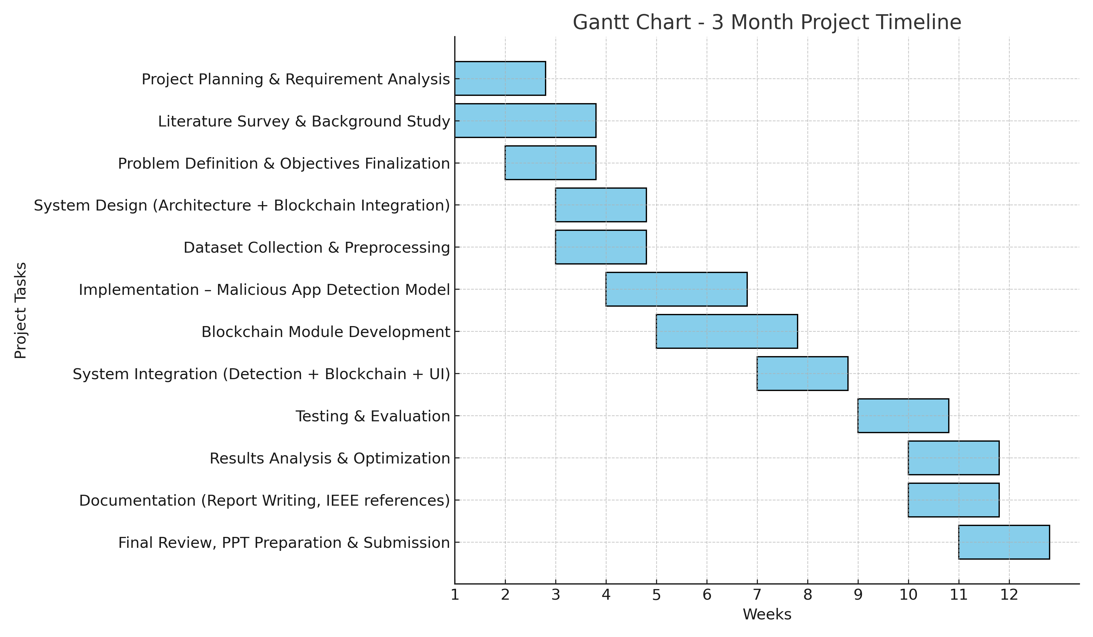
Timeline of the Project (Gantt Chart)

Slide 14
References (IEEE Paper format)
M. Ali et al., “A review of mobile malware detection techniques based on machine learning and deep learning approaches,” IEEE Access, vol. 8, pp. 4961–4976, 2020.
N. K. Shukla et al., “Mobile malware detection techniques: A survey,” ICCCIS, IEEE, 2019.
K. Fan et al., “Blockchain-based secure time protection scheme in mobile edge computing,” IEEE IoT Journal, vol. 6, no. 3, pp. 4671–4679, 2019.
A. Shafaq et al., “Blockchain-based mobile security framework for detection of malicious applications,” IEEE Access, vol. 9, pp. 123456–123468, 2021.

Slide 15


